Slide 1
2017_ver 1.0

Slide 2
Technical Module
2017_ver 1.0
Spill Prevention and Response Planning
Notes:
This Spill Prevention and Response Planning brief is designed to help the Environmental Officer (EO) prepare and plan for releases of hazardous materials (HM). Although the most common spills associated with camps are of petroleum, oils and lubricants (POLs), occasionally more hazardous materials may be released. The paramount issue is the safety of those involved in the release, personnel in the surrounding area and those that are responding to the spill. Planning helps to determine areas where spill risk is highest, emplace countermeasures and develop a plan for a coordinated response.
An important reference document for spill response and planning is NATO’s AJEPP-2, Annex E.

Slide 3
Objectives
2017_ver 1.0
Understand the importance of spill prevention and response planning
Know the key steps in spill prevention and response planning
Be familiar with common spill countermeasures
Know the training and equipment requirements
Be familiar with basic spill response procedures for minor and major spills
Notes:
These lesson objectives emphasize the key points of this briefing.

Slide 4
What is a Hazardous Material (HM) Spill?
2017_ver 1.0
A release of a HM into the air, soil and/or water
Usually accidental
Can pose a hazard to human health, property, or the environment
In camp operations, most spills involve petroleum, oil and lubricant (POL) products
Notes:
In this briefing, a HM spill is a release of HM into the environment whether the air, soil and/or water. Releases into the air can precipitate on the soil or water, releases to the soil may migrate to water or evaporate into air, and releases to water can also go into soil or the air. The EO must be aware of the type of HM and whether it is very mobile due to its chemical properties and where it has been released.
Releases of HMs may negatively impact human health through exposure via respiration (breathing it in), contact with skin or mucous membranes (eyes or nose), or ingestion through food or liquids. Property can be negatively impacted because if it is contaminated, it will not be available for use. Releases can obviously also contaminate the environment itself (for example wetlands, fishing areas, agriculture areas, or groundwater sources).
The most common releases or spills in normal camp operations involve POL products, usually during refueling, maintenance, or traffic accidents.

Slide 5


Significance
2017_ver 1.0
Spills or releases to the environment -
  Can cause exposure to HMs in areas where we work and live
  Can negatively impact human health
  Can impact nearby populations, agriculture, natural resources and cultural resources
  Can give a perception of carelessness or neglect to the host nation, resulting in hostility or lack of support
Planning the prevention of and response to spills minimizes the negative impacts of spills and supports the mission
Notes:
As already noted, spills can impact the environment, resulting in health issues for military personnel, civilians and contractors on the camp.
Spills can also affect people living in the surrounding areas, such as host nation populations or displaced personnel. In addition to health concerns, contamination of natural and cultural resources can also have a socio-economic impact on the area. Examples include: contaminated fishing areas or wetlands can negatively impact the fisheries industry; contamination of parks or cultural resources can cause a loss of tourism; contaminated agricultural lands can eliminate the economic base of a community or region.
Lack of spill prevention or poorly coordinated spill response can give the host nation or surrounding population the impression that the deployed personnel do not care about the host nation. This can result in lack of cooperation on nation building, resource sharing, or mission support. This is why having spill prevention and response plans is so important. Spill planning helps to eliminate or minimize spill risks, helps to protect personnel and supports the primary military mission.

Slide 6
Environmental Officer (EO) Responsibilities during Pre-Deployment/Planning
2017_ver 1.0
Research whether there are spill response capabilities currently available in the host nation
Research whether local industries may have had spills that could impact the camp
Research where there are vulnerable populations or areas
Ensure spill response equipment and personal protective equipment (PPE) is included in load plan
Ensure personnel training and/or certification is current
Notes:
The environmental officer (EO) should research issues pertaining to spill prevention and response. The research may include internet searches, United Nations’ (UN) information, or references such as the CIA World Factbook (https://www.cia.gov/library/publications/the-world-factbook/). If you are an EO taking over from another EO or unit personnel, contact them for assistance and information. For some areas, there may be only limited information available. The first three bullets on this slide list several issues that the EO should investigate during the research.
The EO should ensure that spill response equipment and PPE are included in the load plan. Check training records to ensure certification or training is current for personnel in the unit. If the certification will expire during deployment, ensure personnel get early re-certification or have access to certification training through the internet (if applicable) or with mobile training teams.

Slide 7
EO Responsibilities during Deployment
2017_ver 1.0
Coordinate development of spill prevention and response plan with responsible parties in the command
Work with the command to budget for spill prevention equipment, PPE, response equipment, and disposal costs
Ensure PPE is available and suitable for the types of spills that might occur
Ensure personnel are trained by conducting periodic drills
Act as a member of the spill response team as described in the plan
Ensure spill residues are properly packaged, labeled and disposed
Ensure each spill and associated response is well-documented, to include disposal method and after-action reports (record keeping)
Include spill information on Environmental Conditions Reports (ECR)
Notes:
Deployment responsibilities for the EO include coordinating spill prevention and response planning, implementing and updating the plan, conducting spill response training, and documenting any spills and corresponding response actions.
Appropriate PPE should be determined through researching the types of HM the units in the camp will use and checking the Safety Data Sheets (SDS) for those materials for appropriate PPE. Many PPE manufacturers also will provide (or have online) PPE charts that show which types of PPE should be used for specific HM and hazardous waste (HW). This website also list several sources for SDSs: http://www.ilpi.com/msds/index.html#Internet.
See Annex D of NATO AJEPP-2 for waste management, including hazardous.

Slide 8
EO Responsibilities during Transfer/Closure
2017_ver 1.0
Ensure corrective actions are documented
Ensure spill records are transferred to new unit, organization, or host nation
Refer to Allied Tactical Publication (ATP) 3.12.1.4, Deployed Force Infrastructure, for specific guidance on camp closure procedures
Notes:
During camp transfer, the EO is responsible for ensuring that any information regarding spills and clean-up activities are documented and that those records are transferred to the incoming responsible party.
During camp closure, the EO should ensure documentation regarding the areas where spills and response actions occurred are included in environmental closure surveys and activities. If there are any issues that need to be monitored, be sure to work with legal and real estate staffs to ensure requirements and documentation for the host nation are met.

Slide 9
EO Responsibilities during
Re-Deployment/Lessons Learned
2017_ver 1.0
  Document lessons learned, trends and corrective actions
  Provide feedback to training and doctrine developers so that they can incorporate lessons learned
Notes:
Any issues, trends or corrective actions (whether good, bad or marginal) that surfaced during the development or implementation of the Spill Prevention and Response Plan should be included in lessons learned. The EO should communicate and work with training and doctrine developers to ensure the lessons are incorporated into standard operating procedures (SOPs), manuals, and training exercises so that improvements can be made for future operations.

Slide 10
Initial Considerations for a Spill Prevention and
Response Plan
2017_ver 1.0
START
Level 1: HN or on-site support for spill response and disposal of spill residue?
Yes
Has minimal or no negative impacts on local area or host nation?
Yes
Meets standards and applicable regulations?
No
No
No
Yes
Level 2: Theater/Allied /Contractor support for spill response and disposal of spill residue available or upgradeable?
Yes
Yes
Meets mission requirements?
No
Go to next level on the hierarchy
No
Meets protection needs
(risks minimized)?
Yes
No
No
Level 3: Offsite support for spill response and disposal of spill residue available or upgradeable?
No
Yes
Yes
Authorized to use?
Resource efficient?
Yes
No
Level 4: Field expedient support for spill response and disposal of spill residue available?
Follow or develop plan/ SOP for implementation, monitoring and evaluation and transfer/closure (if necessary)
Yes
No
Level 5: Have all other options been assessed?
No
Yes
Notify Command
No
Notes:
Initial spill prevention and response planning considerations need to take into account the duration and size of the camp operations. Spill response and spill residue disposal support can range from basic for small, short-term camps to complex for large, long-term camps. This flow chart can help with your planning considerations.
To use this flow chart, determine whether or not there is existing capability to support operations with spill response or disposal of spill residue or waste. At Level I, determine whether there is existing support for spill response and/or spill residue disposal available through the host nation (HN) or other source on-site.
If YES, then check the considerations in the loop to the right. These considerations are not sequential and can be subjective. You should use your best judgment to determine which considerations have more weight or are limiting factors in your decision. If the advantages outweigh the disadvantages, you may decide to use that option. If the disadvantages outweigh the advantages, move to the next level of support on the left side of the chart.
Considerations for the level of support:
Meets mission requirements? For example, do they have enough equipment, personnel, and resources for the most probable type of spills and the amount that might be spilled?
Meets standards and applicable regulations? For example, do the procedures and equipment they use meet safety requirements, does their method of spill residue disposal meet your requirements and standards?
Meets protection needs? Protection needs can be interpreted in different ways – it might be force protection in the sense that the people performing the work are documented and trained employees, and are not randomly chosen people who might sabotage the camp in some way. Another type of force protection is ensuring that camp personnel are protected through barriers, evacuation, or shelter-in-place.
Resource efficient? For spill response, this may be a hard issue to evaluate. Issues might include: how does the equipment get its energy to operate? How much fuel does it use? How does the equipment use and dispose of water when it operates?
Authorized to use? What approvals, agreements, legal contracts need to be established to use this support?
Continue through the flow chart until you find the appropriate support.

Slide 11
Spill Prevention and Response
Planning Coordination
2017_ver 1.0
Effective spill response planning cannot be done by the EO alone
Spill response planning requires a team effort to include (but not limited to) personnel from:
  Plans and Operations
  Safety Office
  Logistics
  Public Affairs
  Fire Department
  Security and/or military police
  Medical/Preventive Medicine
  Engineer/Heavy equipment operations
Notes:
Because the EO alone cannot effectively plan for the entire camp, there must be coordination with other camp activities to support spill prevention and response. The planning team may be comprised of different staffs. Recommended staffs are listed on this slide, although additional personnel could be involved as warranted.

Slide 12

Steps to Spill Prevention and Response Planning
2017_ver 1.0
Review of existing information
Risk analysis
Assessment of preparedness, prevention and response controls
Completion of Spill Prevention and Response Plan
Maintenance of a dynamic program
Notes:
The steps to effective spill prevention and response planning include:
A review of existing information, which helps ensure that there are no omissions or inconsistencies in the plan. This review also provides useful information and ideas, and facilitates the coordination of the plan with other plans
A review of risk information, which includes reviews of HM/HW locations or inventories and local facility plans, transportation routes, etc.
A risk analysis, which includes identification of hazards, analysis of vulnerability and determination of risk
An assessment of preparedness, prevention and response controls or capabilities, which identifies existing prevention measures and response capabilities (including potential mutual aid agreements), and assesses their adequacy
The completion of HM planning that describes the personnel, equipment and procedures to be used in case of accidental release of a HM
Maintenance of a dynamic program (i.e., one that adjusts frequently to changing requirements) for plan implementation, maintenance, training and exercises
These steps are explained in more detail in the following slides.

Slide 13
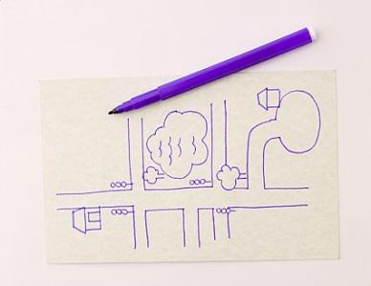


Review of Existing Information
2017_ver 1.0
Environmental studies of the area (including EBS, ECS)
Websites
Command guidelines
Facility plans
Other information
Notes:
By reviewing existing information, you can make sure that there are no omissions or inconsistencies in the plan. This review also provides useful information and ideas, and facilitates the coordination of the plan with other plans
The Environmental Baseline Survey (EBS) should have identified pre-existing conditions to include areas with
Asbestos, polychlorinated biphenyls (PCBs), old dumps, previous spills, previous HM/HW areas, utilities, pipelines, storage tanks, POL areas, etc.
Cultural and natural resources, such as threatened and endangered species habitats
Water resources, water pathways (dry creek beds, drainage, etc.)
Websites that document:
Health assessments/medical issues
Utilities, industrial information, local medical information
Satellite imagery that shows watersheds, drainage, topography
Command guidelines may have existing plans or templates
Facility plans may be more current than the EBS. They would have information on:
Routes for transporting in supplies, POLs, HM and munitions; and routes for transporting out solid wastes, HW and munitions.
Solid and hazardous waste accumulation sites, POL sites, medical areas (including dental, radiographic, etc.)
Facilities with safety equipment and resources
Work areas that may involve hazardous chemicals (e.g., power generation areas, motor pools, aircraft maintenance facilities, pest management areas, ammunition points, grease traps at dining facilities)
Areas of large populations (barracks, mess halls, recreation areas, etc.)
Areas where you can evacuate people to shelter them from exposure

Slide 14

Risk Analysis
2017_ver 1.0
To begin your risk analysis, identify the hazards:
  Potential activities that could result in a release or spill
  Facilities and infrastructure where hazardous spills are most likely to occur
  Other potential occurrences (such as traffic accidents)
Notes:
The first step in risk analysis includes an identification of hazards.
Identify activities or situations that have the potential for causing injury to life, or damage to property and the environment such as construction/demolition, maintenance, refueling, convoys, power generation, ammunition storage, pest control, etc.
Identify facilities and infrastructure where HM/HW spills may occur, such as routes likely to be used for the transportation of HM/HW, storage tank areas, HM/HW storage areas, refueling points, POL storage areas, generator farms, vehicle or aircraft maintenance areas, oil/water separators, ammunition points, amnesty points, hospitals or natural gas facilities.
Identify other potential occurrences that may happen as part of routine camp operations such as traffic accidents.

Slide 15
Analysis of Vulnerability
2017_ver 1.0
Analysis of vulnerability focuses on spills that could have high potential impact:
  To the mission
  Inside and outside the camp
  Extent of area that may be impacted (via air, water or soil)
  Populations that may be affected
  Property that may be damaged
  Environmental resources that may be impacted
Notes:
Risk analysis for spill prevention and response planning also includes looking inside and outside of the camp for vulnerable zones, populations, property and environment that may be affected by a hazardous spill or release.
An analysis of vulnerability focuses on identifying the susceptibility of life, property and the environment to injury or damage if a release occurs.
Determine the potential occurrence of a release as well as the area or population likely to be affected by such a release. (There are websites that can help with this, such as the US Environmental Protection Agency (EPA) website.)
The extent of the vulnerable zone (the significantly affected area) for a spill or release and the conditions that influence the zone of impact (e.g., size of release, prevailing wind direction, water nearby)
The sizes and types of populations (e.g., residents, employees, sensitive populations - hospitals, schools, displaced personnel camps, nursing homes, day care centers) that could be expected to be within the area
The property (e.g., within and outside the camp perimeter) that may be damaged or contaminated, including essential support systems (e.g., water, food, power, medical) and transportation corridors
The environment that may be affected and the impact on sensitive natural areas and endangered species or cultural sites.

Slide 16
Risk Determination
2017_ver 1.0
 |  | Probability
 |  | Frequent | Likely | Occasional | Seldom | Unlikely
Severity | Catastrophic | Extremely High | Extremely High | High | High | Medium
 | Critical | Extremely High | High | High | Medium | Low
 | Marginal | High | Medium | Medium | Low | Low
 | Negligible | Medium | Low | Low | Low | Low
Risk is based on probability (how likely a spill is) vs. severity (degree of adverse impact caused by the spill )
The higher the risk, the more important it is to develop controls to reduce the risk
Controls can be actions or resources to prevent and respond to
spills or releases
Notes:
Risk analysis considers the probability that injury to life, or damage to property and the environment will occur, as well as how severe it might be. (See GTA 08-05-003, Environmental–Related Risk Analysis in references for more information). Thus, there are two components to be weighed: probability (likelihood) and severity.
Determine the probability that a release will occur and any unusual environmental conditions, such as areas being located in flood plains, or the possibility of simultaneous emergency incidents (e.g., flooding or fire hazards resulting in the release of HM).
Determine the severity:
The extent of harm to people (acute, delayed, chronic) and the associated high-risk groups
The extent of damage to property (temporary, repairable, permanent)
The extent of damage to the environment (recoverable, permanent)
With this information, it is then possible to make a risk determination, using a risk assessment matrix, as shown on this slide. For higher risks, you should develop controls such as countermeasures or resources to prevent or respond to spills and releases. How you implement these controls will be the basis of your Spill Prevention and Response Plan.

Slide 17
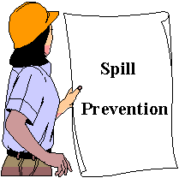
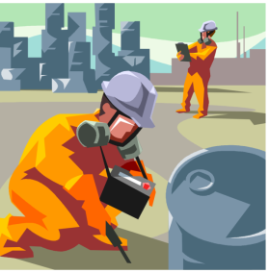
Assessment of Controls
2017_ver 1.0
Determine what countermeasures and resources are required based on your risk assessment
  Examples of mitigating measures
    Secondary containment
    Monitors and alarms
    Engineering controls
    Shelters
  Personnel resources
    HM/HW responders (possibly Chemical units)
    Firefighting
    Law enforcement
    Medical
    Engineer/heavy equipment support
    Public Affairs
  Equipment resources
    Personal Protective Equipment (PPE)
    Spill response equipment
Notes:
Based on the controls that may reduce your risk
Assess what controls you have available such as existing prevention aids or mitigating measures and response resources (including potential mutual aid agreements). This slide lists the types of controls that might be considered.
Assess if the existing controls are adequate.
If there are gaps in needed countermeasures or resources, work with the commander and planning team to determine how to obtain the countermeasures and resources required.

Slide 18
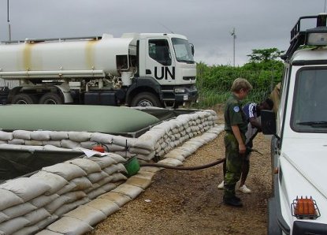
Prevention Measures for POL
Storage and Refueling Points
2017_ver 1.0
Trained and equipped personnel
Secondary containment for tanks and bladders
Overhead cover to prevent exposure to the elements
Tank overflow or leakage alarms or monitoring systems
Accident prevention barriers
Clear labels and signage
Fire suppression equipment, fire extinguishers
No smoking signs
Spill response equipment
Hardstand or poly with sand bags under fueling areas to protect soil
Drip pans under refueling hoses, valves
Storm water runoff prevention (block drains, or prevention of POL products from leaving the site)
Notes:
Areas such as POL storage and refueling points have a higher probability of spills and can be high risk areas. Here are some examples of mitigating measures that can help prevent spills in these areas.
Overhead coverage for open secondary containment should be considered. For example, a spill pan providing secondary containment can overflow when there is heavy rain.
See AJEPP-2, Annex E for more detail on secondary containment requirements, which are also discussed further in these slides.

Slide 19
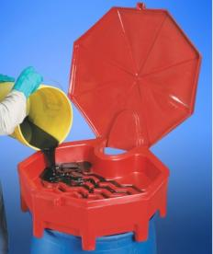
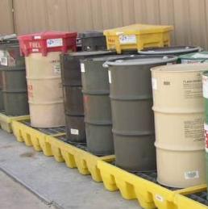
Spill Prevention Measures in
Vehicle Maintenance Areas
2017_ver 1.0
Trained and equipped personnel
Spill kits and PPE
Good housekeeping and best management practices when dealing with HM
  HM storage (small amounts) located near workstations
  Legible labeling on containers
  Recycling of materials such as anti-freeze, used oil
  Secondary containment
  Keeping containers closed (use self-closing drum funnels or other equipment)
  Grounding of flammable/explosive materials
Oil and water separators
  Need to be inspected regularly and cleaned as needed
Safety Data Sheets (SDSs) available for personnel
Hardstand or containment to prevent contamination of soils from drips, leaks, etc.
Drip pans under leaking vehicles (be sure to empty drip pans in the oil water separators when necessary, such as after a rain storm)
Notes:
Areas for vehicle and aircraft maintenance also have higher probability of spills and can be high risk areas. Here are some examples of countermeasures to help prevent spills in these areas.

Slide 20
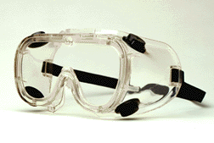
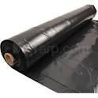
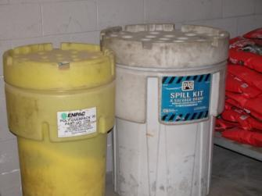
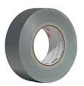


PPE and Spill Kits
2017_ver 1.0
PPE (gloves, protective eyewear, boot covers/boots, overalls or protective suits, masks or respirators, if applicable)
Sorbent materials and pads
Container with sealable lid (to put clean-up material in)
Broom and dustpan
Shovel
Bung wrenches
Other items (e.g., polyethylene sheet, duct tape, different size wooden plugs, wire and wire cutters, pliers, channel locks, screwdrivers)
Notes:
Spill kits should include PPE and response equipment. The PPE and sorbents should be compatible with the hazardous material they are most likely to be used to clean up. It is important to ensure PPE is in good condition and not expired; respirator cartridges, gloves, suits and boots can all have shelf-life dates.

Slide 21
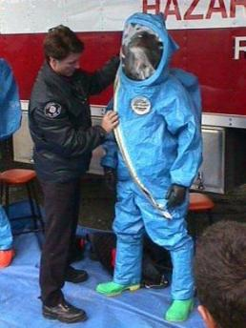
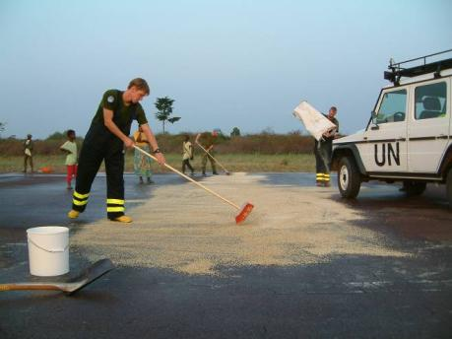
Develop a Spill Prevention and Response Plan
2017_ver 1.0
Spill Prevention and Response Plan Topics
  Lines of authority and notification of personnel
  Response procedures for minor and major spills
  Evacuation/Shelter-in-place procedures
  Available references or reach-back capability
  PPE and response equipment; exposure limits
  Decontamination and clean up procedures
  Disposal and remediation
  procedures
Notes:
The Spill Prevention and Response Plan should include:
Description of countermeasures in place to prevent/reduce spills
Description of the personnel, equipment and procedures to be used in case of accidental release of a HM
Notification of spill response team
Lines of authority
Spill team members and responsibilities (incident command, logistics, safety officer, science officer, medical officer, entry team, decontamination team, security, public affairs, etc.)
Reporting/Communication procedures (A spill report form should be developed as part of the plan)
Procedures providing reliable, effective and timely notification by the facility emergency coordinators to persons designated in the emergency plan, and to the camp/public, that a release has occurred
Evacuation plans, including provisions for a precautionary evacuation and alternative traffic routes
Decontamination procedures
Disposal and remediation procedures. Disposal of spill and decontamination debris and residue is a big task. It will usually have to be disposed of as HW. Be sure to decontaminate equipment, including heavy equipment, fire trucks, tools, etc. If proper procedures are not taken, you may have to decontaminate the medical transport vehicles and medical facilities from contamination by victims and casualties.

Slide 22

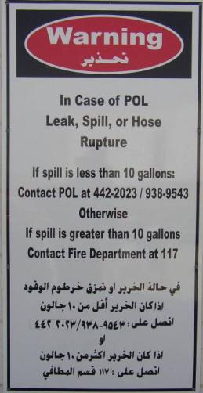
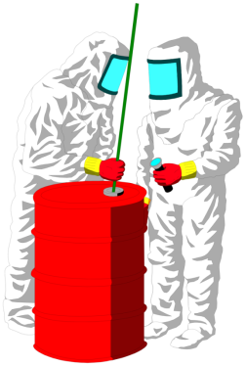
Components of a Dynamic Program
2017_ver 1.0
Plan implementation
Plan information posted
  Emergency contacts
  Basic instructions
  Evacuation routes
  Location of equipment
  SDSs
Personnel training
PPE fitting and maintenance
Combined exercises
Incident After-Action Reviews (AARs)
Plan review/revision
Notes:
Once the Spill Prevention and Response Plan is written, the program to implement it must be developed. Plan information should be posted in areas you have identified as having a high potential for spills or vulnerabilities. Information should be easy to read and followed. Maps and diagrams showing evacuation routes, equipment, water ways, etc. are helpful.
The dynamic program should include:
Personnel training on countermeasures or response procedures applicable to them
PPE fitting and maintenance
Exercises that involve spill response team members to ensure clear understanding of roles and smooth working relations
After Action Reviews (AARs) to determine what worked, what did not work and how to fix any problems (corrective actions)
How often the plan should be reviewed or revised (this should be done either on a specific time interval or when there are changes in the camp mission, size, duration, operations)
Corrective actions from the AARs should be incorporated into the plan.

Slide 23
Program Recommendations
2017_ver 1.0
Periodically request that units submit information on their HM inventories, hazardous waste (HW) accumulation areas, and diagrams of their areas
Share new information with law enforcement, medical services, fire fighting units and chemical units
Inspect mitigating measures routinely for proper use and integrity
Practice drills (table top and live) with all involved personnel as required, including when there are changes in personnel or camp conditions
Notes:
It takes many people and current information to make an emergency plan work well. The EO should request updated information from activities that pertain to the plan. This information should be communicated immediately to spill response members and also incorporated into the revision of the plan.
Mitigating measures should also be monitored to ensure they are in good condition, are effective and are being used properly.
Having a plan that is practiced may save lives!

Slide 24
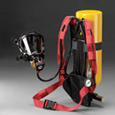
Lessons Learned: Common Problems
2017_ver 1.0
Unclear lines of authority
Non-compatible communication equipment or no pre-set communication channel
Thresholds or limits for response personnel (especially with explosive conditions) not set
PPE and other equipment not maintained
Playing hero – not taking time to assess the situation before acting
Notes:
These are some common problems and issues that have occurred in previous responses to incidents. Be sure your plan addresses these issues. You should also be sure to routinely conduct inspections and evaluations in order to avoid these issues.
Use lessons learned from others and from your own AARs to improve your plan and enhance your response capabilities.

Slide 25
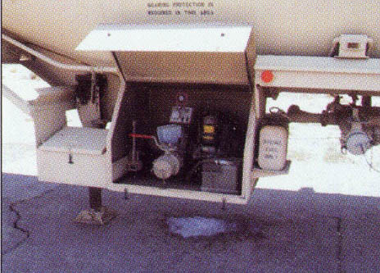
Spill Response for Minor Spill Situations
2017_ver 1.0
The following slides on spill response can be informational or used as training slides for your personnel
Notes:
All personnel need a basic understanding of spill response procedures. The following procedures are for minor spills (the definition between minor and major spills may be determined by your command). Depending on the chemical spilled, minor spills are usually only a small amount (volume) and will not quickly reach a body of water. Usually a major spill involves a large amount and/or has potential to reach a body of water. Most personnel should be trained for responding to minor spills. For major incidents, personnel should have specialized training or certification in Hazardous Spill Response Operations. Chemical officers and some firefighting specialists often have hazardous spill operations training.

Slide 26
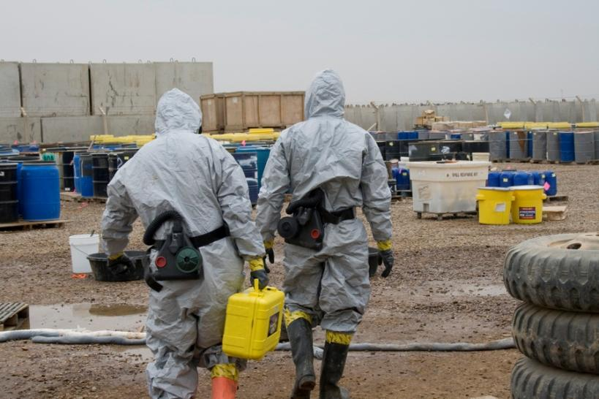
Prerequisites
2017_ver 1.0
Training
Equipment
Notes:
All personnel who respond must be trained and have proper equipment. If you don’t have the training or the equipment, you should not respond except to protect yourself and call for help.

Slide 27
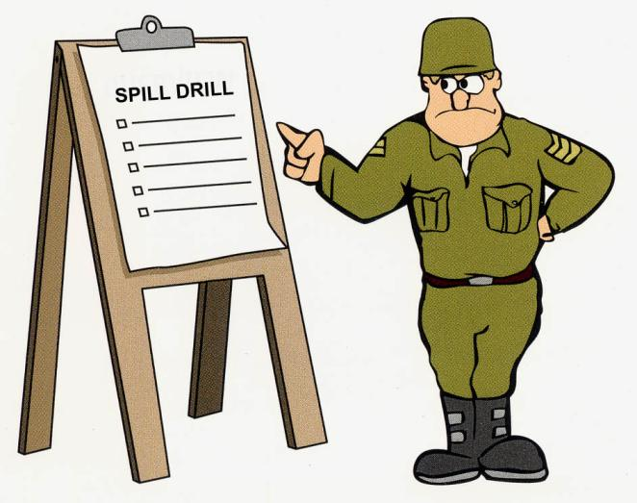
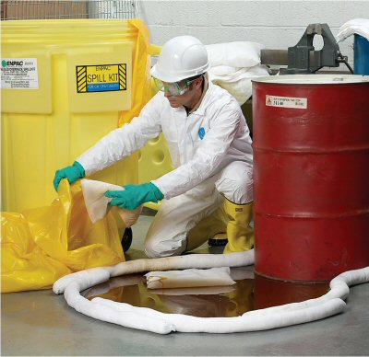
Training
2017_ver 1.0
Classroom/online
Hands On
Notes:
Personnel must not only have the “theory” in the classroom; they should also have “hands on” training where they have to practice what they have learned. People should learn how to use PPE and spill response equipment in a controlled training environment before having to use it in an actual response.

Slide 28
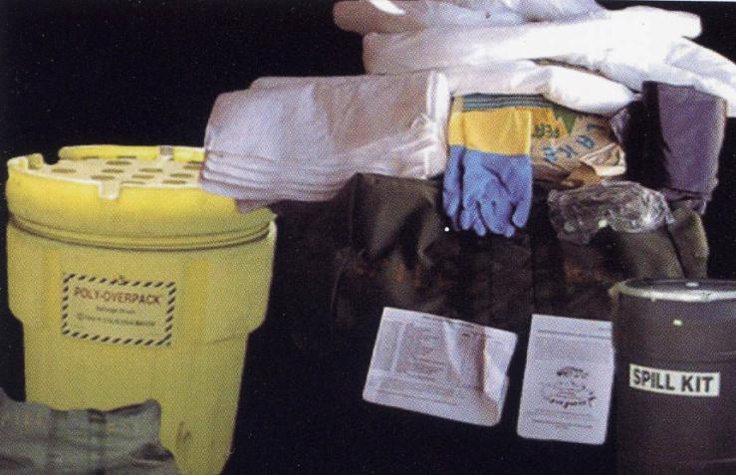
Equipment
2017_ver 1.0
Personal Protective Equipment
Spill Kit
Notes:
Personnel should have PPE that is appropriate for the type of spill they will most likely encounter. Remember that the types of gloves and boots used must be compatible with the chemical you are dealing with. Most manufacturers of PPE have compatibility charts to identify which PPE product should be used for specific HM spill/release response. Spill kits should also have appropriate equipment for the most likely scenario. For example, you would not want to place a leaking container of acid in a metal drum that would corrode from contact with the acid.

Slide 29
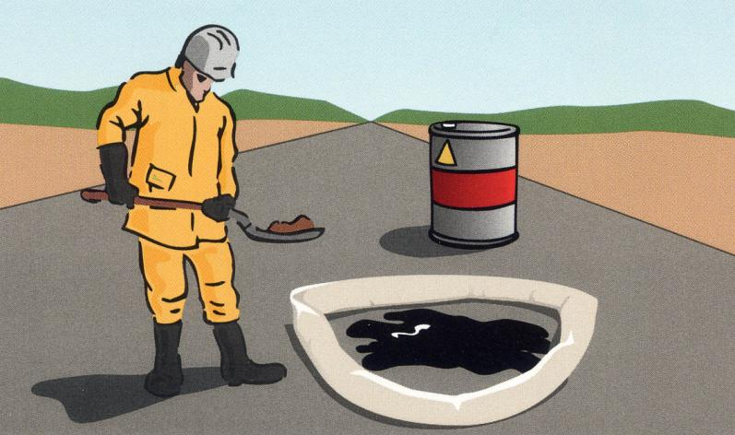
Spill Drill
2017_ver 1.0
Protect Yourself
REACT
Remove the source
Envelop the spill
Absorb/accumulate
Containerize/clean-up
Tell your supervisor
Notes:
ALWAYS protect yourself (and others) first. If you are not trained to the level of response needed, cordon off the area and send for help. If you have the training and equipment to respond, then REACT. The steps for REACT will be described in more detail in later slides.

Slide 30

Decision and Action
2017_ver 1.0
Assess the situation
  What substance is spilled?
  How big is the spill?
  Is the spill still occurring or spreading?
  Can it get larger or reach water?
  What size perimeter boundary needs to be set up?
  What is the wind direction?
Notes:
Before taking action, assess the situation. This slide lists some of the things you should do when making this assessment.

Slide 31

Protect Yourself
2017_ver 1.0
Is it SAFE for me and other soldiers?
  NO > Evacuate, set up a perimeter/barrier, and call for help
  YES > Get your equipment and REACT
Notes:
After you assess the situation, decide on a course of action, keeping in mind the safety of yourself and others.
Each step in “REACT” is described in the following slides. Remember REACT stands for:
Remove the source
Envelop the spill
Absorb/accumulate
Containerize/clean-up
Tell your supervisor

Slide 32
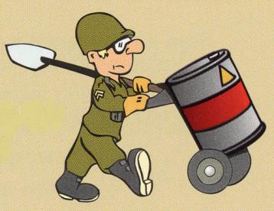
REACT - Remove the Source
2017_ver 1.0
Shut down power to pumps, motors and anything else electrical
Close off gas lines
Seal or re-pack leaky barrels
Use drip pans and repair leaky vehicles
Tighten leaky hose connections
Close valves
Notes:
Ways to remove the source of the release include: Sealing or re-packing leaky barrels; using drip pans and repairing leaky vehicles; tightening leaky hose connections; closing valves; and shutting down power to pumps.

Slide 33
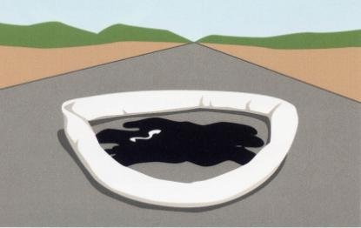
REACT - Envelop the Spill
2017_ver 1.0
Use absorbent pads or socks to stop the flow
Use absorbent booms to curb the spill
Use absorbent booms or pads to protect waterways/drains
Shovel the surrounding soil to create small dams or berms
Protect waste bodies by covering sewer grates or blocking water outlets
Notes:
To envelop the spill: stop the flow, curb the spill, protect waterways and drains, and/or create dams or barriers.

Slide 34
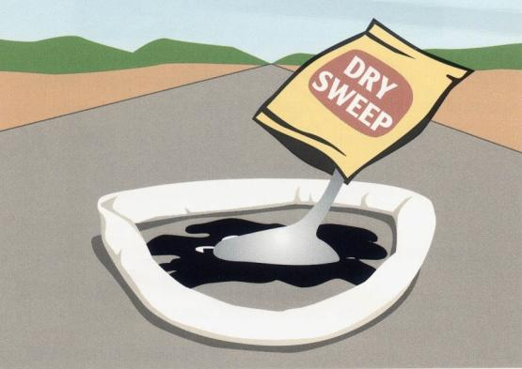
REACT - Absorb/Accumulate
2017_ver 1.0
For liquid spills
  On a hard surface, use dry sweep
  On mud or gravel, use absorbent pads
Notes:
Liquid spills can be hard to stop, especially on mud, gravel or sand.

Slide 35
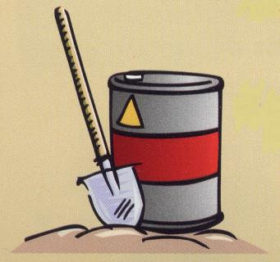
REACT - Containerize/Clean
2017_ver 1.0
Place absorbent material into a bag or container
For small spills, remove contaminated soil and containerize it
  For POL spills, petroleum field test kits can help determine how much to remove
Dispose of spill residue properly
Intermediate and major spills require a clean-up team
Notes:
All spill contamination and debris must be properly containerized and disposed of. For POL spills, field test kits can help to determine how much soil must be removed. Don’t forget that all cleanup equipment (PPE, other equipment, and even decontamination equipment) must be decontaminated. If the equipment or PPE is not reusable, it must be disposed of properly. The decontamination water must also be disposed of properly.

Slide 36
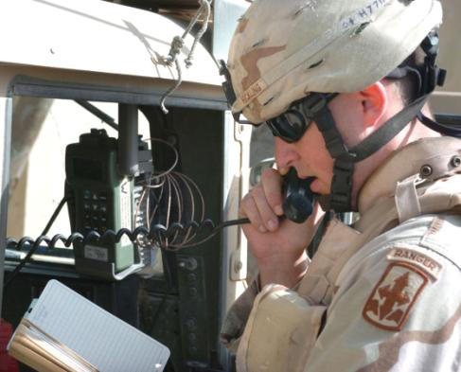
REACT - Tell Your Supervisor
2017_ver 1.0
Tell Your Supervisor
  What, where, when and how
Work with supervisor to prepare a Spill Report
Notes:
As part of your Spill Prevention and Response Plan, you should have reporting procedures. Soldiers and other personnel should know when and to whom they should report.
Your command may have a specific spill report template or may use a more general environmental incident report.
Examples of both such forms can be found in the “template” section in the Reference Module of this toolbox.

Slide 37
Spill Report
2017_ver 1.0
Contact information
Date, time, and location of spill
What and how much was spilled?
What action was taken?
What damage occurred?
What additional assistance/action is needed?
Notes:
Spill reports should be submitted through the chain of command. This slide lists the types of information a spill report should contain. As noted in the previous slide, this toolbox has a template for a spill report, which can be found in the Reference Module.
The EO should maintain a copy of the spill report and should keep it with the camp’s other environmental records.

Slide 38
Spill Response for Major Spill Situations
2017_ver 1.0
Notes:
For major incidents, personnel should have specialized training or certification in Hazardous Spill Response Operations. Chemical officers and some firefighting specialists often have hazardous spill operations training.
The Incident Commander with his spill team (primarily the safety officer, the EO and the medical officer) should determine whether they have the capability to respond to a major spill. If not, they should do whatever is feasible and call for higher-level support.

Slide 39
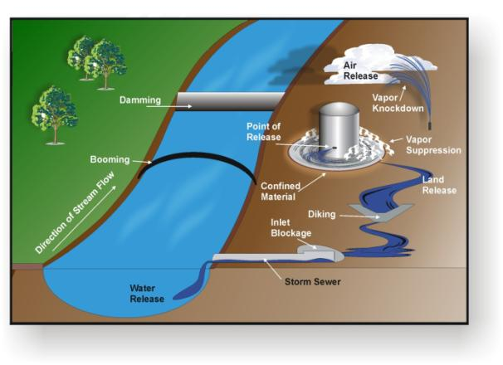
More Complex Response Actions
2017_ver 1.0
Major Spill Response
REACT still applies, but…
  More complex to control (remove source and envelop the spill) the material
  May involve air, water and/or soil all at the same time
  Clean up is often on a larger scale
Containerizing and disposal of contaminated material, soil and water is more complex and must be managed properly
Notes:
Major spill response actions are similar to minor spill response actions, so the “REACT” formula is still appropriate to use. But, major spills are more complex. To be effective, you must select hazardous materials spill procedures based on factors such as:
• The properties of the released material
• Characteristics of the release event and subsequent migration of the material
• Site-specific conditions and considerations
When your spill response team is determining the appropriate procedures to use, consider the type of release involved. Releases will be classified as either land, air, or water releases, and appropriate confinement or control techniques are needed for each type of release.
Note the relationship between different types of releases. For example, a single large-scale land release may conceivably result in air and water releases, as well as soil and groundwater contamination, as an incident runs its course. To be fully effective in minimizing harm, responders may be required to engage simultaneously in different types of response operations at multiple locations. Thus, responders should fully assess all potential outcomes of the release event before selecting the procedures appropriate for the type and scope of the spill.
The safety of response personnel should always be the highest priority when selecting and performing response operations.
After the spill has been enveloped, specialized equipment such as pumps, absorbent materials, or heavy equipment may be required to containerize the contaminated material. The containers must be properly labeled and disposed of in a manner that meets host nation requirements. This may require coordination with chain-of-command to determine which disposal options can be used (or are best to use): retrograding, landfarming, using HW incineration or burial in a HW landfill.

Slide 40
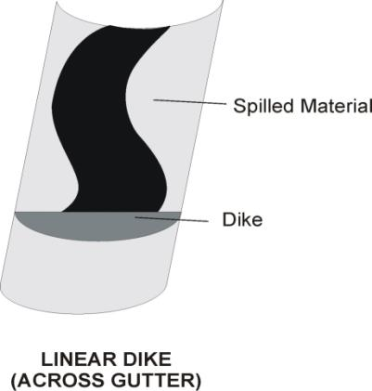
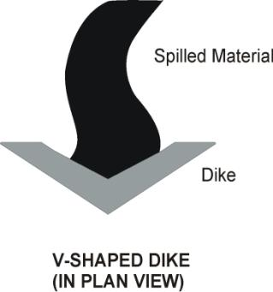
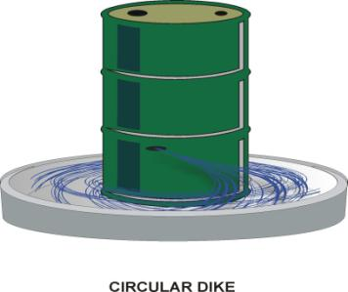
Land Releases
2017_ver 1.0
Control Procedures
  Diking
  Diversion
  Inlet Blockage
Basic Dikes
Notes:
When HMs are spilled on the ground, the speed and direction of their migration within the environment will largely depend on the physical properties of the material involved and the topography (the shape of the earth’s surface), and the type of soil in the vicinity of the release location.
To effectively control land releases, you must predict the path the released material will follow and attempt to intercept and confine the product at some downstream point along that route. This interception point must be far enough in front of the spill to allow adequate time for responders to create confinement structures, such as dikes, before the product arrives, but not so far as to sacrifice too much soil to contamination.
Basic control procedures involve creating temporary structures using whatever materials are available or can be rapidly obtained. Equipment and supplies that may be used include the following:
Shovels • Dry granular solvent • Barrier booms
Picks or mattocks • Salvage pump • Sorbent booms
Sandbags • Salvage drums • Bagged material
Sorbent socks, pillows • Plastic sheets, tarps, or salvage covers

Slide 41
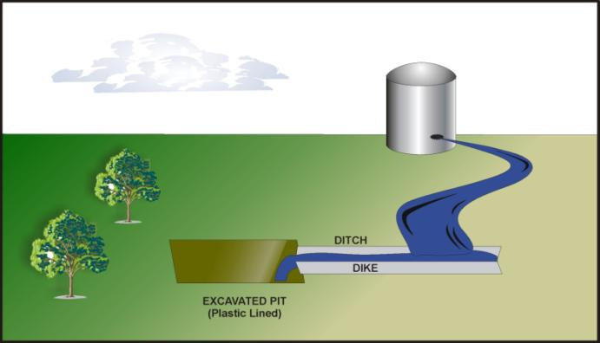
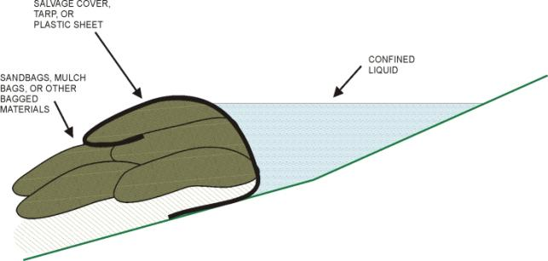
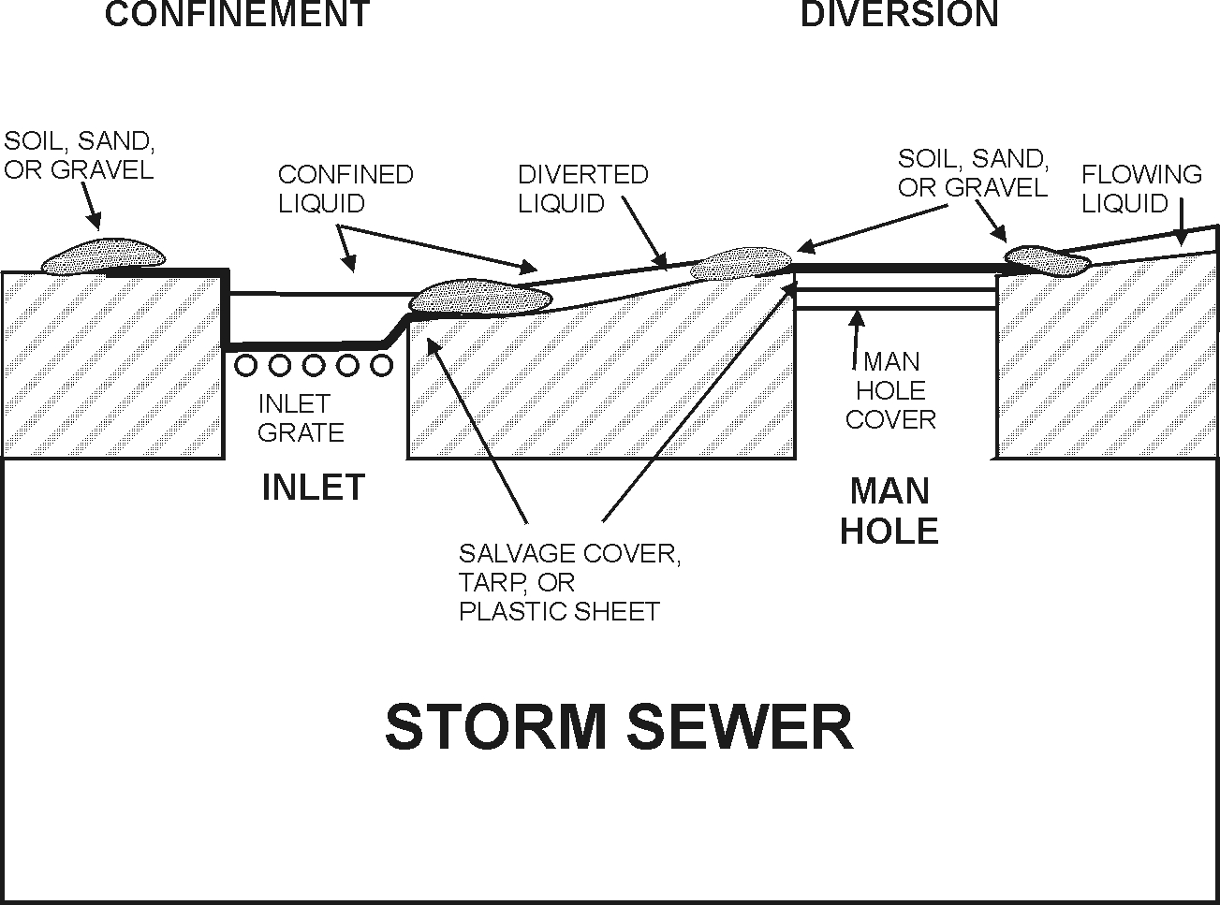
Land Releases
2017_ver 1.0
Diversion into a Pit
Improvised Dike
Inlet Blockage
Notes:
Diking involves constructing relatively impermeable barriers to block the flow of a spilled HM. Dikes can be constructed in straight, V-shaped, or circular configurations. Dikes must be the appropriate size and configuration, taking into consideration the characteristics of the spill involved. For example, material flowing along a ditch may be readily confined by placing a simple dike or dam across the ditch. In contrast, for product migrating in sheet flow down a gradual slope or along a broad, shallow depression, a longer V-shaped dike may be necessary. You can use dikes in series so that incidental leakage from one structure will be confined by the next. The arrangement also provides for backup in case of dike failure.
Diversion involves setting up control structures to divert liquid products away from places we do not want them to go, such as storm sewers, and into locations we do want them to go, such as catch basins. For example, ditches or trenches can be created in front of a spill to divert the spill to prevent significant exposure or to direct the spill into a confinement structure. Linear dikes and barrier booms may also be employed in diversion operations.
Inlet blockage is used to prevent HM from entering storm sewer systems or other highly sensitive locations. For example, plastic sheets, tarps, salvage covers, and/or mats can be used in conjunction with soil, sand, or other suitable materials to block gutter inlets, drainage gates, and manhole covers, which feed the storm sewer system and, in turn, the surface water system. Inflatable bags, which may be obtained commercially, may be placed in drain and sewer pipes and inflated to form a tight seal. In some instances, barrier booms or sorbent booms may be placed around entry points to confine or divert the product.

Slide 42
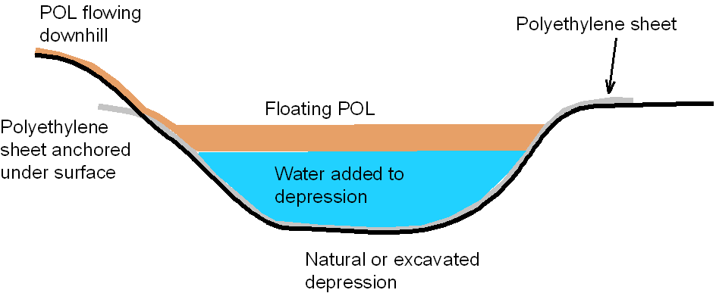
Land Releases
2017_ver 1.0
Capturing POL in a Depression
POL flowing downhill
Floating POL
Notes:
Depressions, either natural or excavated, can be used to contain POL. If the quantity of POL exceeds a natural depression, it can be excavated (before the POL reaches it) to hold the POL. If there is time, lay out a polyethylene sheet in the depression to minimize contamination of the soil. If a polyethlyene sheet is unavailable, add water to the depression to make POL float, which will thereby limit contact with the soil. The advantages to using this method are that it is: quick, flexible, and buys time to stop the leak. The disadvantages of this method is that it is dependent on topography and that the contaminated soil may be difficult to excavate.

Slide 43



Releases into Surface Water
2017_ver 1.0
Use floating booms to contain the spill:
Prevent the movement of oil or liquids lighter than water
Use commerically available oil absorbent socks and booms
Can be improvised and made of tree branches, wood or hay bales
Must be attached to shore to prevent POL or light liquids from escaping
“Universal” absorbants like sawdust are not effective on water
Skimmers or pumping equipment will be needed to remove the contaminant and place it into containers for ultimate disposal
Notes:
Spills in water can be difficult to contain. Weather conditions, especially high winds and choppy water, create especially difficult response conditions.
Liquids that are lighter than water will float and may be contained with floating booms. The booms should be attached to shore to secure the spill.
For liquids heavier than water, currents at low levels may cause contaminants to migrate downstream. A dam should be created to contain the contaminated liquid. Use a pump to suction the liquid into containers for proper disposal.
If the liquids are soluble in water, the rate of solubility (how fast they dissolve) will determine whether it is feasible to contain the spill.

Slide 44
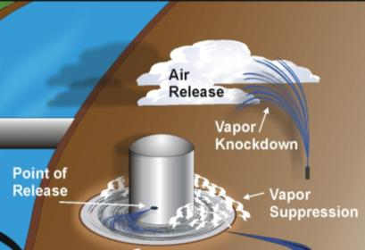
Releases into Air
2017_ver 1.0
The response to HM released into the air depends on the vapor density, the toxicity and the quantity of the chemical
Usually requires evacuation or shelter-in-place for people in the area
Recommend using reach-back capability, such as a chemical or environmental engineer or technical guidance such as the Emergency Response Guidebook or Hotline, for expertise
Vapor lighter than air may require vapor knockdown or evacuation of the area until the chemical dissipates
Vapors heavier than air require vapor suppression and neutralization
Notes:
Air releases usually are the most difficult response operations. How heavy the vapors are (whether they float or sink in air), the toxicity and the amount of vapors released are considerations in selecting your response procedures.
Air releases can form a plume and spread down wind. It may be necessary to evacuate personnel out of the plume or to shelter-in-place.
Response teams should be aware of potential air releases for their area and it should be documented in the Spill Prevention and Response Plan. However for unexpected vapor releases, reach-back capabilities can help to determine proper response actions, if time allows.
There can also be air releases of fibers, such as with renovation or demolition of asbestos-containing materials. Prevention measures, such as encapsulating the area or using water to prevent fiber release, should be taken.

Slide 45
Remediating POL-Contaminated Soils
2017_ver 1.0
Bioremediation
  Soil composting, soil farming, landfarming
  No need to add micro-organisms
Phytoremediation
  Using plants to break down POL in soils
Gasoline is harder to degrade than diesel and lubricants
  Gasoline is toxic to flora and micro-organisms
  However, surface spills of gasoline usually vaporize
Polycyclic aromatic hydrocarbons (PAHs) are more difficult to remediate
Halogenated hydrocarbons are very difficult to remediate
Notes:
Methods for remediating POL-contaminated soils depend on temperature, precipitation or water availability, and having enough land area to be able to bioremediate. Bioremediation or phytoremediation is preferrable to incineration of contaminated soil.
POL can be food for microbes. Given enough time, POL will degrade naturally (“natural attenuation”). Phytorememdiation is another option, if growing conditions are optimal.
The EO should work with environmental engineers to determine if actively cleaning up a spill can cause more damage than the contamination itself. In such cases, it is also important to take into consideration that this can be difficult to explain to the affected population (political considerations). Moreover, some types of hydrocarbons are more difficult to remediate than others, as noted on this slide.
In this case, as in the case of other remediation examples, the extent to which spills are remediated will obviously depend on the type of contingency operation you are participating in, the security risks, etc.

Slide 46
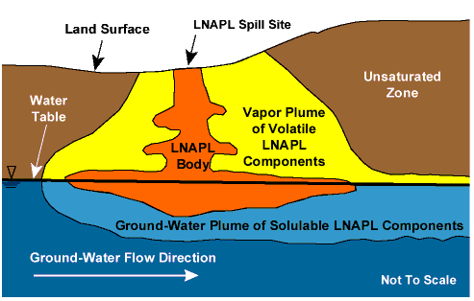
Remediating POL in Groundwater
2017_ver 1.0
Potential loss of use of the area
Cannot be done without extensive resources and specialist support
  Pump and treat
  Reactive barriers
  Air sparging
Extremely expensive
Takes a very long time
Impossible to remediate 100%
LNAPL: Light Non Aqueous Phase Liquid (i.e. diesel)
Notes:
If a spill should reach groundwater, it is very difficult to remediate or clean up. An environmental engineer or environmental professional will be needed to oversee this type of operation. It is best to prevent contamination of the aquifer if at all possible.

Slide 47
Conclusions
2017_ver 1.0
Spill Prevention and Response Planning is the best way to prevent or minimize contamination of soil, air and water. It will help build good relations with the host nation and avoid legal liability
Spill Prevention and Response Planning and plan implementation are a team effort
Spill Prevention and Response Programs are an important part of mission readiness and force health protection
Effective spill response protects people and the environment of the surrounding area, helping to build good relations
Notes:
Spill Prevention and Response Plans and programs are the best way to prevent and minimize contamination of soil, air and water.
The EO cannot implement spill prevention and response alone; it takes a multi-disciplined team from across the camp.
Spill Prevention and Response Programs are an important part of mission readiness and force health protection. Effective spill response protects the people and environment of the surrounding area, which in turn helps to build good relations.

