Slide 1
2017_ver 1.0

Slide 2
Technical Module
2017_ver 1.0
Natural Resource Protection

Slide 3
Objectives
2017_ver 1.0
Understand the importance of protecting natural resources in a base camp and the surrounding area:
For deploying troops’ safety, health and reputation
For local and broader security considerations
For future generations
Employ practices to minimize negative impact and enhance positive impact
Establish a management process for these considerations
Lack of information and awareness is the primary reason natural resources are damaged
Notes:
There are a number of reasons why it is important to protect natural resources when setting up and operating at a base camp. Showing respect and concern for local natural resources can help ensure the health and safety of the deploying forces, as well as enhance the reputation of the deploying forces in the eyes of the host nation and the international community. Demonstrating this awareness and appreciation can contribute to good relations with the host nation; importantly, failing to show such an appreciation can result in serious strains in the relationship. Finally, it is important to consider the value these resources will have to future generations.
This briefing walks through some of the practices that can be observed to ensure that the protection of natural resources are taken into account. It offers examples of the positive impact following such practices can have, and of the negative impact when these resources are not protected. As many of these examples illustrate, often it is the lack of information that can lead to unintended consequences. Having the necessary information available is an important first step.
This briefing emphasizes the importance of having a management process in place to take these considerations into account.

Slide 4
What Natural Resources Need to be Protected?
2017_ver 1.0
Wildlife, especially protected and endangered species
Flora and fauna
Habitat (soil, water, airspace)
eco-systems
critical habitats
conservation areas
bird areas
migration routes
Notes:
“Natural resources” encompass wildlife; flora and fauna; and the habitats in which they live. Of particular concern are those natural resources that have been designated as “protected” or “endangered.”

Slide 5
Why Should You Care?
2017_ver 1.0
Protection of natural resources in a base camp can:
have potential effects on local food supplies
preserve unique and endangered resources that can be of worldwide significance
foster good will from local government and community
maintain local community and potential future tourism assets
Failure to do so can
strain relations with the local community or host nation
adversely impact overall sustainability
impact climate change
Meeting mission requirements is paramount, but every effort should be made to protect these resources to the extent possible
Notes:
It is important to recognize up front that meeting mission requirements is the paramount mission of the military operation, and the threat level will affect the extent to which natural resources protection can be taken into account. At the same time, it is required by international law to make every effort to protect these resources to the extent possible. What should not be tolerated is the intentional damage and destruction of such resources without any military justification (e.g., soldiers intentionally killing an animal that has been designated as an endangered species as a trophy).
This slide lists a number of the reasons why it is important to care about the protection of these resources. This information is important to convey to all deploying forces. Inadvertent damage to significant (especially protected) natural resources can complicate the attainment of the desired strategic end state through the loss of political goodwill, negative public image, and increased overall cost.

Slide 6
Examples of Laws and Regulations
2017_ver 1.0
International examples
UN Convention on Biological Diversity (1992)
UNESCO, Convention Concerning the Protection of the World Cultural and Natural Heritage
Convention on International Trade in Endangered Species of Wild Fauna and Flora (CITES)
European Union’s Natura 2000
Also consider
Own nation’s laws and regulations (e.g., U.S. Lacey Act)
Those of the host nation
Mission regulations
Notes:
The UN Convention on Biological Diversity, which came into effect in December 1993, is the main international instrument for addressing biodiversity issues. Its website (www.cbd.int) offers a range of information.
The importance of protecting natural resources is also encompassed in a number of other international documents, several of which are cited here.
It is equally important to know the laws of your own country. For example, the Lacey Act requires that all U.S. citizens must abide by all the wildlife laws of the country they are in as well as by U.S. laws even when they are out of the country. Military personnel are further subject to the Uniform Code of Military Justice for potential violations of General Order I-B, DTR 4500.9-R and CCR 600-10. (These requirements are noted by the Wildlife Conservation Society in its document, “Wildlife Trade Training Fact Sheet for Military Stationed in Afghanistan or Iraq.”)

Slide 7
EO’s Responsibilities
2017_ver 1.0
Access websites, public and government documents prior to deployment (e.g., UN’s Convention on Biological Diversity website)
Be familiar with and understand applicable laws and policies (international, your own nation’s, mission regulations, host nation law, etc.)
Work with local, international subject matter experts (SMEs), e.g., NGOs, academics
Identify protected indigenous plants and wildlife and their habitats during base selection and set-up
Create a list of protected natural resources within the base (and area of operations), and keep it updated. Provide this information to the base commander so that troops can be given guidance to try to:
Avoid adverse effects if possible
Minimize direct impacts and collateral damage if avoidance is not an option
Recovery: when natural resources have been damaged, take appropriate responses and reactions
Maximize respect for and protection of natural resources; this can result in greater mission success
Document information prior to transfer and/or closure of the base camp
Notes:
The responsibility for natural resources protection will likely fall to the environmental officer. It will be important to do whatever research is possible ideally before deployment, to be aware of what wildlife, flora and fauna might be in the deployment area, especially those that may be on the protected or endangered list. This slide lists a number of the preparatory steps that should be taken to develop this baseline knowledge.
Subject matter expertise about the region where the base is being set up (and in the area of military operations) may be found at the local and national level in the host country (e.g., Ministry of Environment, zoos). There may also be SMEs in your own country or in international organizations (e.g., non-governmental organizations that focus on wildlife and natural resources like World Wildlife Foundation, Wildlife Conservation Society, National Geographic Societies). The UN Convention on Biological Diversity website (www.cbd.int) offers a range of reference materials.
Once the initial baseline of information is available—both for the base and the area of operations—it is important to keep the base commander apprised of any updates to this information to ensure proper guidance is given to all the troops. The main principles for the troops should be to: avoid adverse impacts if possible; minimize damage if complete avoidance is not possible; when natural resources are damaged, take appropriate action; and maximize respect for these resources. (These points are taken from Laurie Rush et al., The Cultural Minefield.)
Finally, when either transferring the base to another command or when closing the base, it is important to document all the information: what natural resources are there (at the base and in the area), their condition, any actions taken to repair any damage, etc.

Slide 8
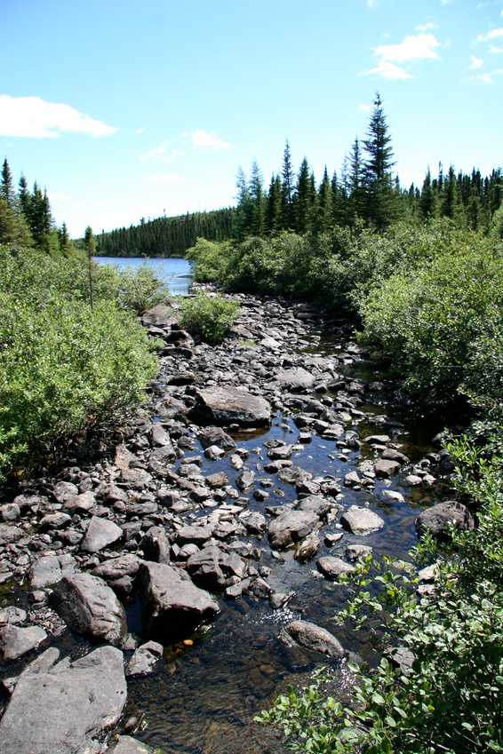
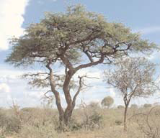
What You SHOULD Do
2017_ver 1.0
Avoid movement in and around sensitive habitats as much as possible
Minimize off-road damage as much as possible
Cross streams only at authorized points
Avoid unnecessary destruction of vegetation
Notes:
There are a number of ways to protect natural resources during deployments. While military operations will sometimes prevent being able to take these considerations into full account, the more the natural environment can be protected, the better this will be for everyone. This and the following slide suggest ways to conduct your activities to minimize any negative environmental impact.

Slide 9
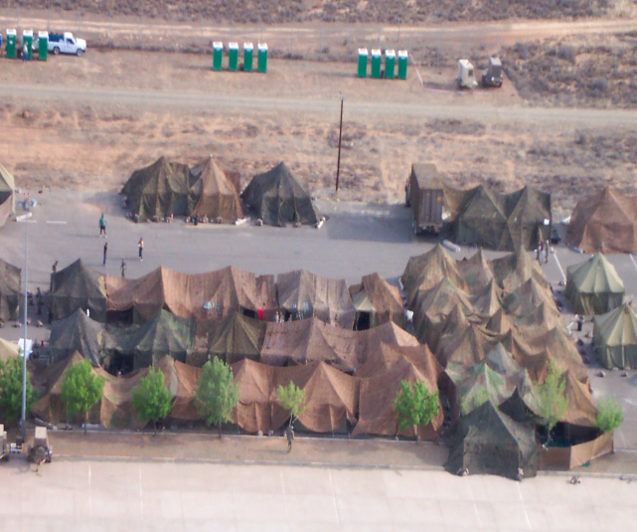
What You SHOULD Do
2017_ver 1.0
Refrain from clearing vegetation on steep slopes or along streambeds
Prevent base camp from being stripped of vegetation
Use camouflage nets
(instead of branches from
live trees)
Instruct troops to report
injured animals

Slide 10
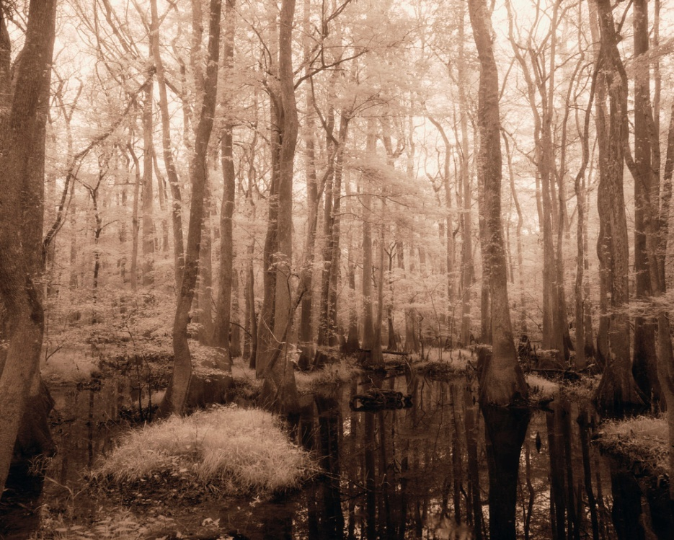
What You Should NOT Do (unless militarily required)
2017_ver 1.0
Do not drive directly up steep hills or through wetlands
Do not alter the courses of waterways
Do not take flora or fauna samples
Do not damage trees or habitats unnecessarily
Notes:
Just as there are a number of ways in which natural resources can be protected, there are a number of actions that can have a negative impact. The next several slides offer examples of what should NOT be done, unless it is militarily necessary to do so.

Slide 11
What You Should NOT Do
2017_ver 1.0
STOP BUYING WILDLIFE PRODUCTS FROM AFGHANISTAN!
Unnecessarily disturb, capture, hunt or collect as pets any wild animals
Buy wildlife products while deployed
There may be fewer than 100 snow leopards left in Afghanistan. If you buy snow leopard pelts, you are violating the law, and driving snow leopards to extinction.
Find out more about the conservation of Afghan wildlife at www.wcs.org/afghanistan.

Slide 12
What You Should NOT Do
2017_ver 1.0
Do not improperly dump trash—it can attract wild animals, which can present threats to humans (as well as animals)!
Notes:
This picture was taken in connection with a military exercise conducted in 2012. It displays a site where contractors supporting the exercise used a waste dump because the area did not have adequate infrastructure to support waste disposal requirements of the mission/contract.

